Slide 1


K N Parthiv Rishi
Food Trends: Understanding Customer Preferences in Food and Beverage
Daily, Weekly, and Monthly Planner

Slide 2



Introduction
Objective:
Approach:
  To analyze consumer behaviour and emerging trends in the food and beverage industry.
  Identify what drives customers’ food choices — taste, price, ratings, and availability.
  Used Power BI for interactive data visualization.
  Analyzed patterns in pricing, ratings, and category popularity.
Outcome:
Provides actionable insights for businesses to improve menu design, pricing, and customer satisfaction.

Slide 3

Problem Statement
Current Scenario:
  Food preferences are rapidly changing due to digital influence and lifestyle shifts.
  Customers value quality, price, ratings, and health more than ever.
Key Problem:
  Businesses lack data-driven insights to track changing preferences.
  Inability to predict demand patterns or satisfaction drivers.
Need:
  A structured approach using analytics and visualization to uncover hidden patterns and improve decision-making.

Slide 4
Tools and Technologies Used
1. Microsoft Power BI
Created interactive dashboards for trend and customer analysis.
  Used slicers, filters, and DAX measures for dynamic exploration.
  2. Microsoft Excel
  Data cleaning and preprocessing (missing values, formatting, derived columns).
  Ensured dataset readiness for Power BI import.
  3. Power Query Editor
  Performed data transformation and merging within Power BI.
  Enabled accurate relationships and simplified visuals.
  4. DAX (Data Analysis Expressions)
  Used for calculated fields (e.g., average rating, total sales, price–rating ratio).

Slide 5
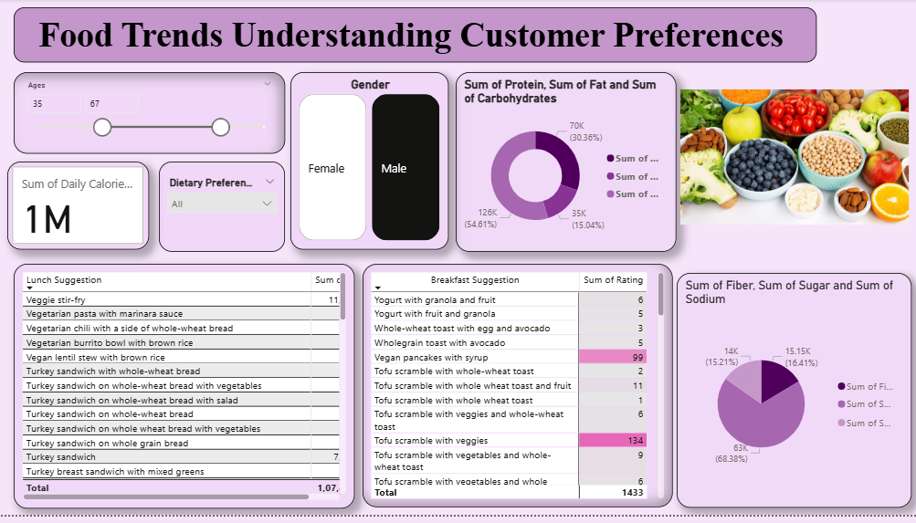
DASHBOARD
This is a very comprehensive overview of customer nutrition and meal preference.
It shows total calorie targets across all users using KPI indicators.
Insights get more personalized with Slicers for Age, Gender, and Dietary Preference.
The donut charts represent Protein, Fat, and Carbohydrates intake percentages.
Another donut portrays the contribution Fiber, Sugar, and Sodium do in diets.
Each of the Lunch and breakfast suggestion tables gives the foods with their ratings and prices.
It helps identify which meals together are healthy and affordable.
It uncovers eating preference differences between male and female users Facilitates understanding of the connection between user demography and meal choices.
Paves the way for further investigation of nutrition behavior.

Slide 6

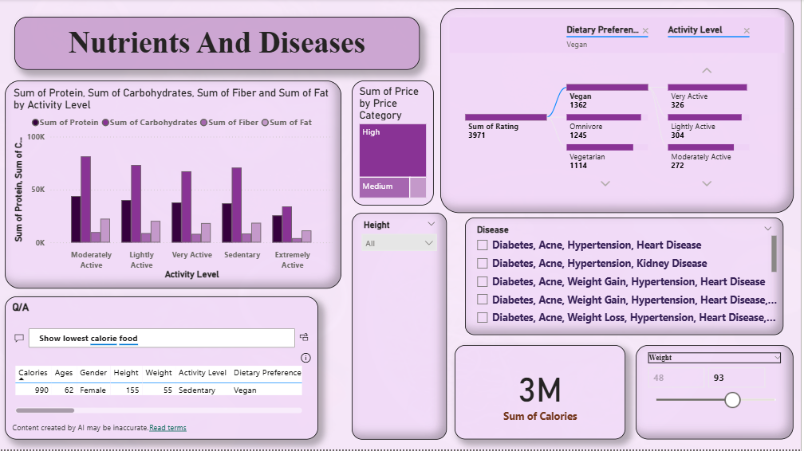
This dashboard aims to compare dietary groups such as Omnivore, Vegetarian, Vegan, and Pescatarian.
The KPI cards summarize average calories, total protein, and total fat consumed across all subjects.
The Tree Map provides disease distribution by diet type, pinpointing at-risk categories.
The donut chart serves to compare gender distribution, showing an equal level of participation among the data.
The scatter plot displays sodium versus sugar levels for each disease.
The snack suggestion table presents well-known and highly rated snack options.
The age and weight of respondents are broken down by a bar chart, providing a demographic perspective.
Gauge chart shows the mean rating for various foods and tracks trends in satisfaction.
Slightly lower disease rates in the vegetarian and vegan groups were noted.
Understanding how dietary habits influence nutrition balance and health outcomes.
Analysis of macro-nutrients, protein, carbs, fat and fiber against activity level and disease occurrence.
Clustered column chart compares activity level nutrient consumption.
Tree Map showing total food price by the price category and therefore showing affordability distribution.
Bar chart links dietary preferences with activity pattern.
Table of diseases such as Diabetes, Hypertension, Obesity, etc., for analysis.
Visualisation of total calorie consumption across all users as Card visual.
Weight and height slider filters to dynamically explore body data.
Q/A box to help quickly identify the least caloric foods for specific conditions.
This highlights the association between poor diet with diseases such as hypertension or obesity.
Contributes to improved understanding of how a lifestyle along with nutrition affects well-being overall.

Slide 7
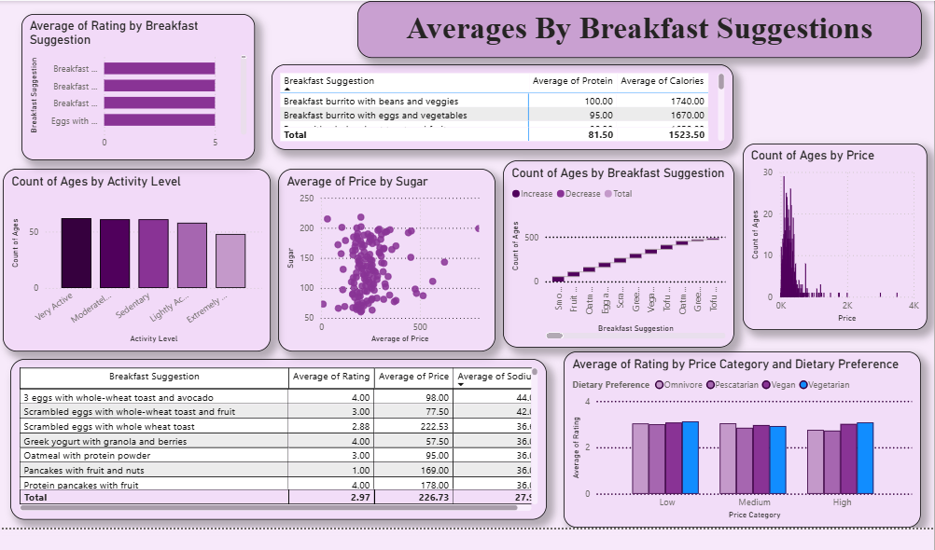
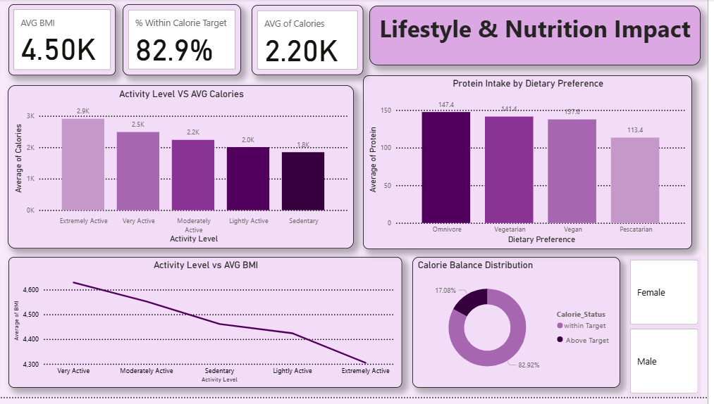
Thoroughly informing themselves about trends in breakfast food and their impact on ratings, nutrient content, and cost.
Average ratings for varying breakfast items are compared on an appropriate bar graph.
Values of macronutrients (protein, calories, and sodium) are presented for each breakfast item via tables.
A scatterplot, befitting the scheme representing money-quality trades, effectively studying sugar versus price and getting healthier choices shown.
Line plotters represent the distribution of age in favour of a particular breakfast food type as per generation.
With a histogram, it calculates age versus money spent bringing about their habits of being big spenders.
A comparative visualization defines the concessions between categories of pricing, dietary preferences, and average ratings.
Explains the relation between the profiles of those nutritious but affordable and well-liked morning foods.
The costliest breakfasts fall outside the realm of highest satisfaction.
These insights are very informative to supply planners at food banks looking to conceptualize a balanced and economical set of morning meals.
This dashboard connects lifestyle habits with nutritional outcomes.
KPI cards show Average BMI, % Within Calorie Target, and Average Calories.
Clustered column chart compares activity level vs. calorie intake showing higher calories for active people.
Line chart displays Activity Level vs. Average BMI, revealing how fitness level affects body index.
Donut chart splits calorie status into Within Target vs. Above Target categories. Column chart shows average protein intake across dietary preferences.
Gender slicer enables detailed comparison between males and females.
Reveals that very active individuals consume more calories but maintain healthy BMI levels.
Demonstrates link between balanced diet and meeting calorie goals.
Provides actionable insights for designing personalized fitness and diet plans

Slide 8
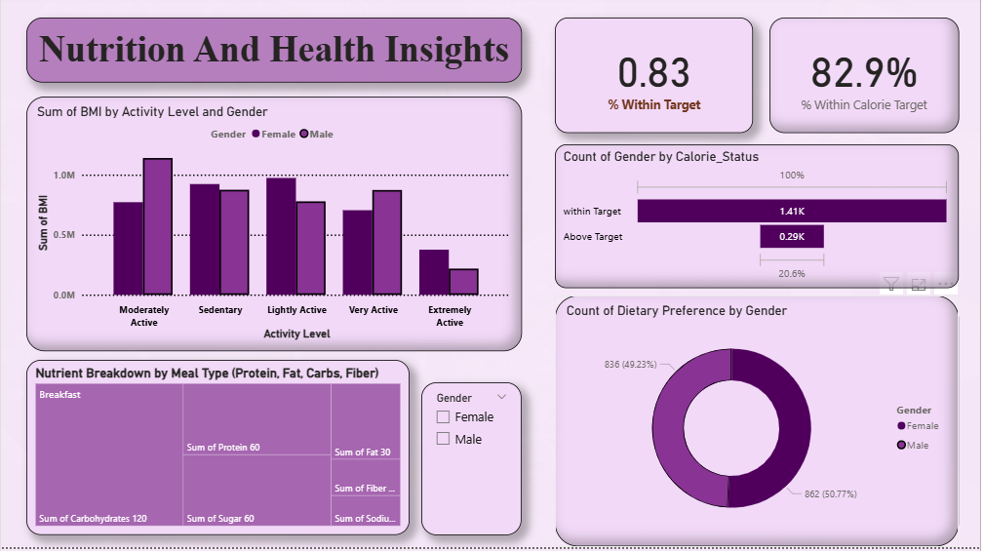
Interrelates gender, activity, and nutrition status.
Majority, that is 82.9% of the participants, remain within the limits of their calorie target; this implies a lot of balanced diets.
BMI levels are highest among the sedentary and lightly active groups and especially among females.
Tree maps show the nutrient distribution by meal types, where carbohydrates considerably contribute the most.
For calories, the gender difference shows that females slightly score better than males in conforming to their calories.
The Donut chart indicates that there are equally balanced distributions of gender over dietary preferences (≈49% female, 51% male).
KPIs account for the consistency of health with calorie adherence and BMI levels.
Instruction offers insight to connect activity level and meal composition to overall health outcome.
Makes direct comparison possible on the patterns concerning calorie control and nutrient intake across gender in a short time.
Confirm that moderate activity and a balance of meal types contribute to the achievement of healthier BMI scores.

Slide 9

Benefits of the Project
1. Data-Driven Decision Making
Empowers restaurants to make choices based on actual data,
not assumptions
2. Customer Preference Insights
Reveals what customers like/dislike using ratings and reviews.
3. Market Trend Identification
Detects seasonal demand and emerging food trends.
4. Strategic Business Improvement
Optimizes pricing, promotions, and menu offerings.
5. Interactive Visualization
Simplifies complex datasets into clear, engaging
visuals for stakeholders.

Slide 10

Applications of the Project
  1. Market Analysis – Identify trending food items and forecast demand.
  2. Customer Insights – Segment customers by satisfaction and behavior.
  3. Product & Menu Optimization – Improve or introduce high-performing items.
  4. Inventory Management – Align supply with predicted demand; reduce waste.
  5. Marketing Strategy – Target promotions based on popular and trending items.
  6. Regional Insights – Customize offerings based on location or cultural trends.

Slide 11
Challenges and Limitations
1. Data Quality Issues
Missing values, duplicates, and incomplete records affected precision.
2. Limited Dataset Scope
Lack of demographic or regional attributes restricted deep analysis.
3. Static Dataset
Dashboard used Excel data — no real-time updates or API connections.
4. Subjectivity of Ratings
Customer opinions may not reflect true quality.
5. Technical Complexity
DAX formulas and large datasets increased dashboard complexity.

Slide 12
Conclusion and Future Works
Conclusion:
Power BI effectively revealed patterns in food preferences, pricing, and satisfaction.
Demonstrated the value of analytics in decision-making and trend forecasting.
Future Enhancements:
Integrate real-time data from food delivery APIs.
Apply machine learning for predictive trend analysis.
Include demographic and regional factors for deeper insights.
Use sentiment analysis on customer reviews for emotional insights.
Expand scope to sustainability and health-based trends.

